Slide 1
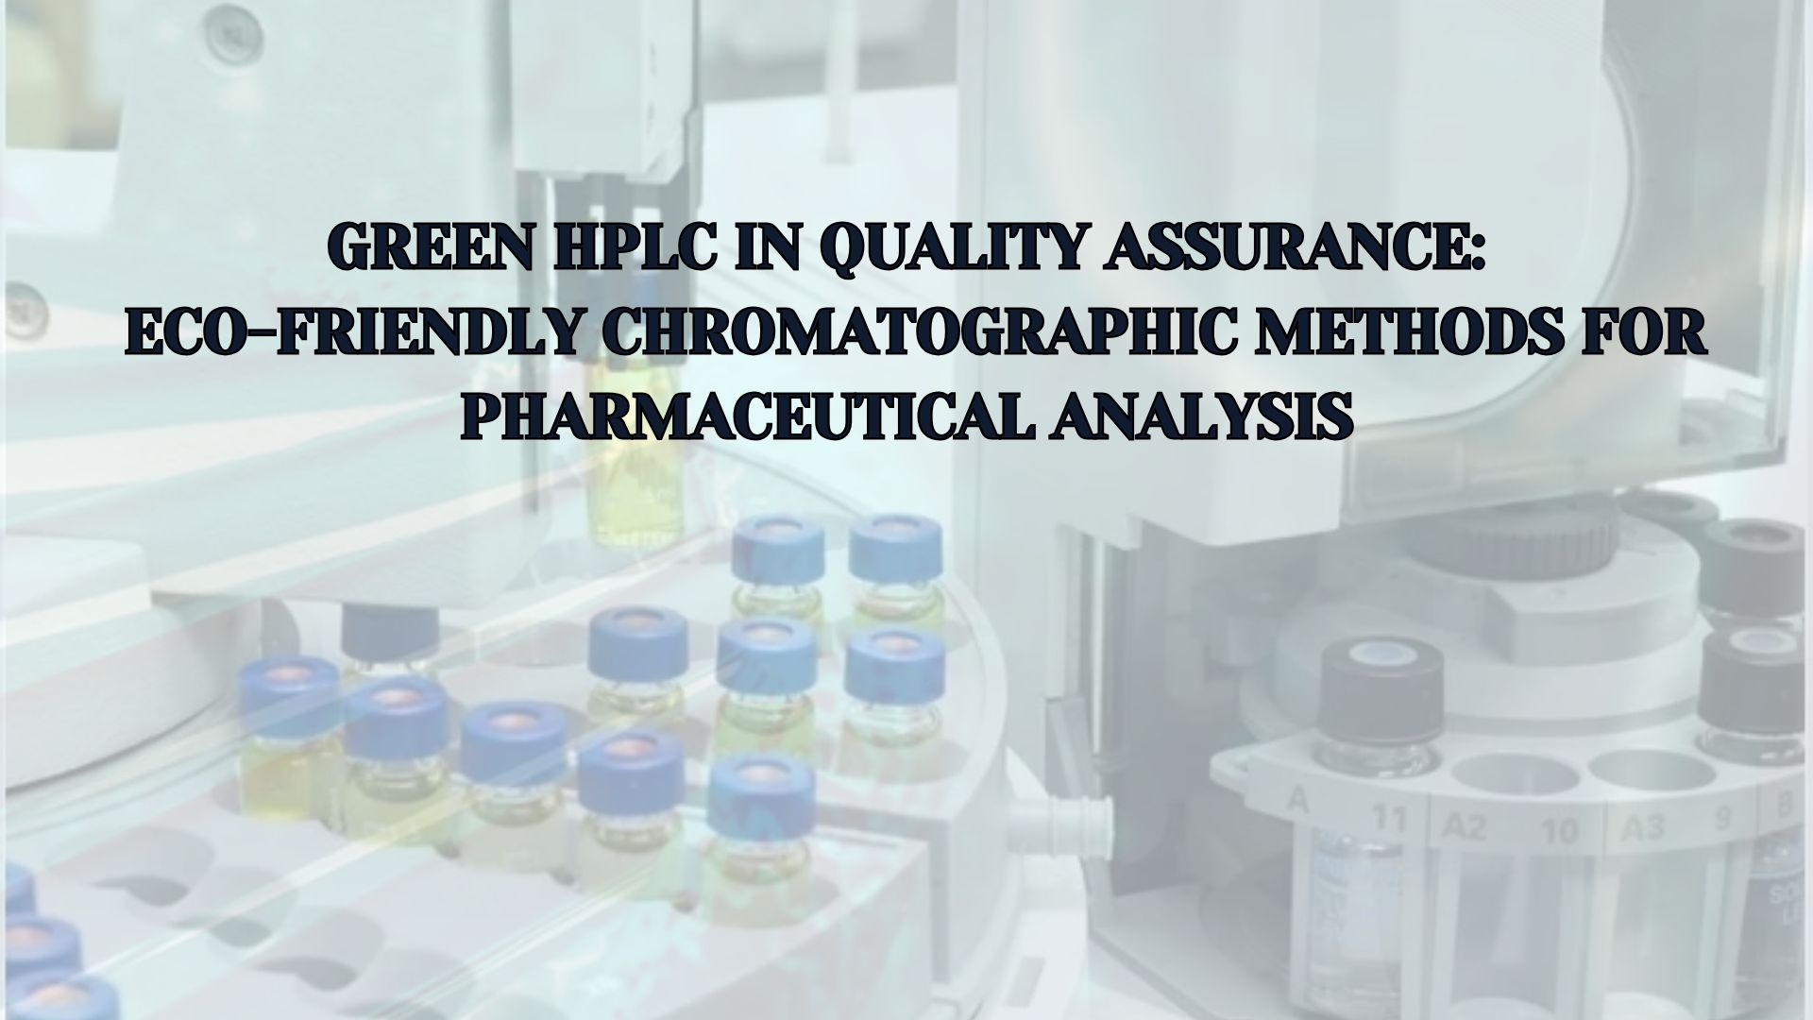
Mansi Bhatt
M.Pharma, quality assurance
Gyanmanjari Innovative University

Slide 2
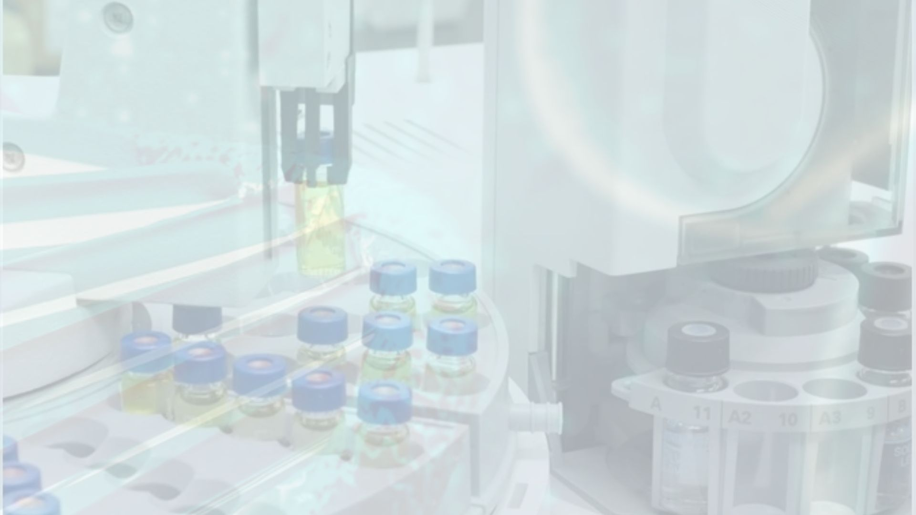

INDEX
CONTENT
6. Review of Literature
7. Novelty and Innovation
8. Principles of Green Analytical Chemistry
9. Strategies for Green HPLC
10. Solvent and Mobile Phase Selection
Introduction
Background
Problem Statement
Research Gap
Research Objectives
11. Regulatory Trends in Pharma QA
12. Green HPLC–QA Framework
13. Method Development & Validation
14. Case Study Example
15. Applications in Pharmaceutical Analysis
16. Implementation Challenges
17. Environmental & Occupational Impact
18. Future Directions
19. Conclusion
20. References

Slide 3
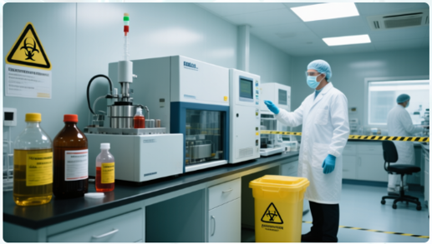
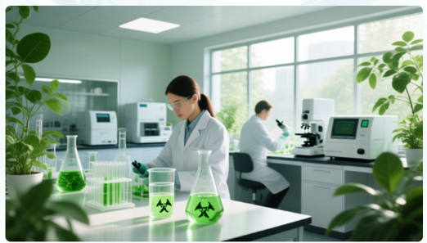
INTRODUCTION
HPLC is a vital analytical technique used widely in pharmaceutical quality assurance to ensure drugs meet purity, safety, and efficacy standards.
However, traditional HPLC methods involve use of toxic solvents that pose environmental and health risks.
The need to adopt greener, sustainable analytical practices in pharma is urgent and aligns with global sustainability goals.

Slide 4
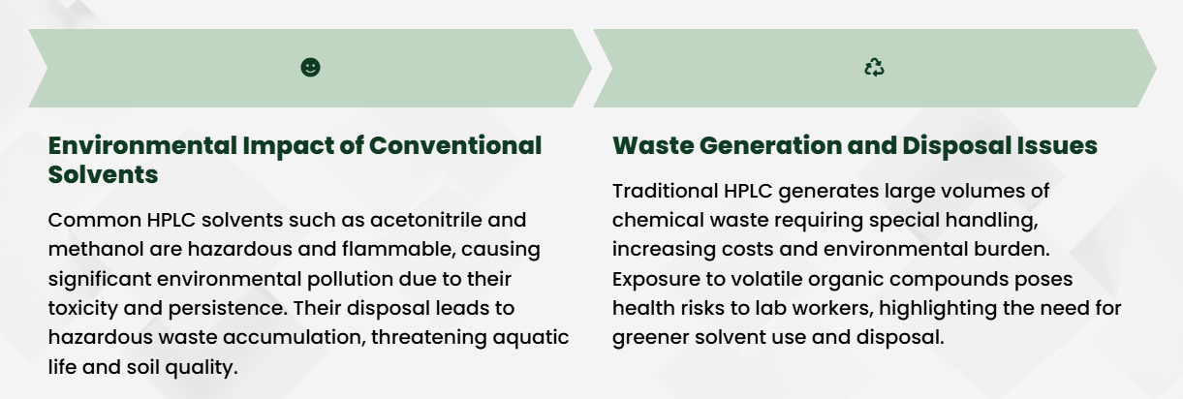
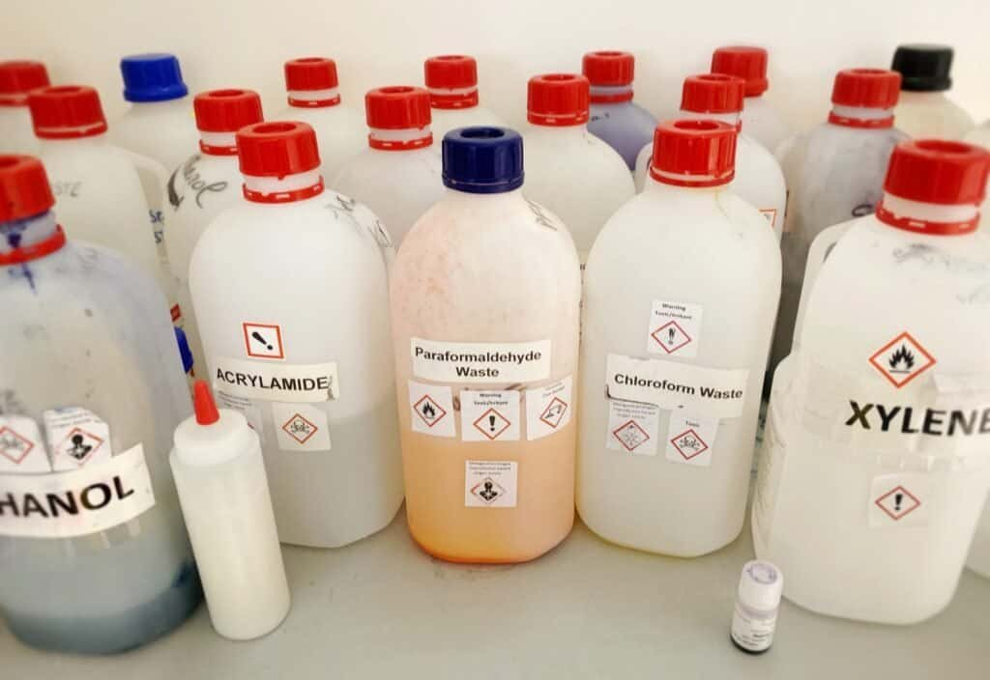
Background: Environmental Concerns of Traditional HPLC

Slide 5
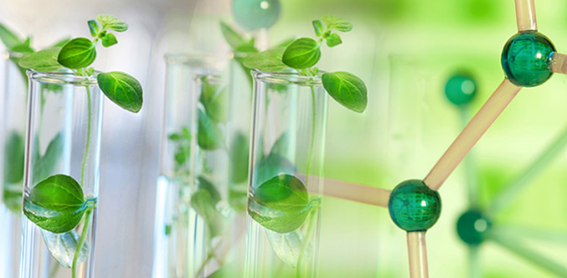
PROBLEM STATEMENT
Despite advances in green chemistry, many pharma labs still rely on toxic solvents and outdated QA frameworks.
This causes environmental pollution, employee health risks, and increased disposal costs.
There is a clear need for validated green HPLC methods integrated into pharma QA systems.

Slide 6
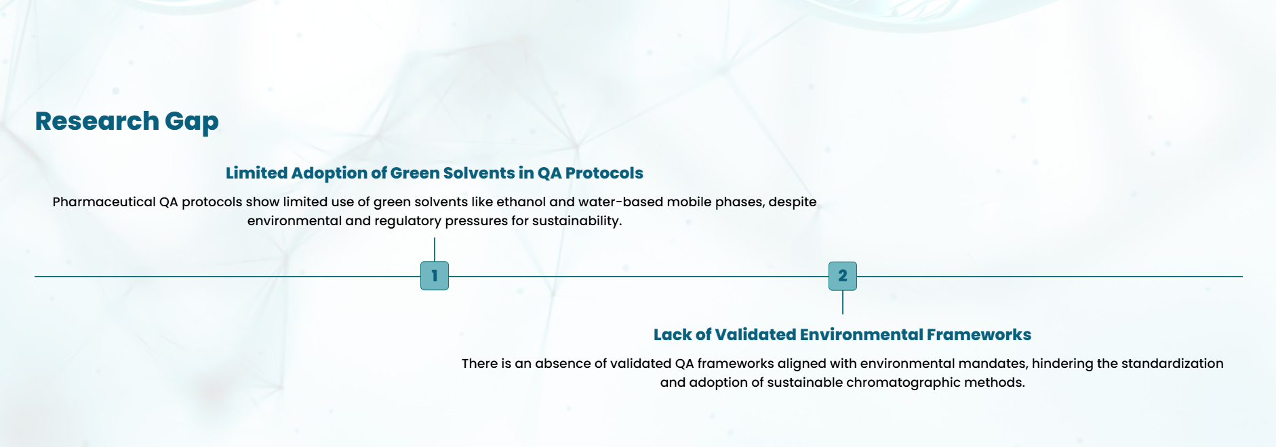
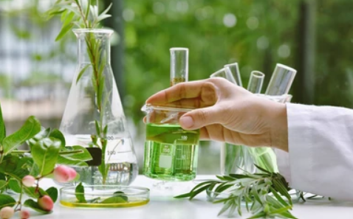
RESEARCH OBJECTIVE
Develop chromatographic methods using green solvents and sustainable mobile phases.
Create a Green HPLC QA framework combining eco-solvent optimization with robust validation metrics.
Demonstrate that green HPLC can equal or surpass traditional methods in resolving power and accuracy.

Slide 7
RESEARCH QUESTION
How can toxic solvents in HPLC be replaced with greener alternatives for pharma analysis?
Does green HPLC maintain sensitivity and accuracy compared to traditional methods?
What metrics are best for validating eco-friendly HPLC methods in QA?
How well do green HPLC approaches comply with regulatory standards?
What are the technical, cost, and operational barriers to green HPLC adoption?
Can automation and design strategies improve the development of sustainable HPLC protocols?

Slide 8
LITERATURE REVIEW
Early RP-HPLC (Reversed Phase HPLC) methods heavily relied on toxic solvents; recent studies focus on substitutes like ethanol, water, and deep eutectic solvents for sustainable analysis.
Greening strategies include micellar and solvent-free HPLC, validated in pharmaceutical applications for drugs such as favipiravir and nirmatrelvir, showing comparable sensitivity and selectivity.
Computational tools and quality-by-design (QbD) approaches guide the selection of green stationary phases and mobile phases, ensuring method optimisation and robustness.
Validation metrics (AGREE, GAPI, Eco-Scale) are increasingly used to quantify the greenness and sustainability of developed methods across drugs including ibuprofen, phenylephrine, losartan, and carvedilol.
Case studies demonstrate significant reductions in hazardous waste and costs by employing aqueous or bio-based mobile phases, while maintaining regulatory compliance and analytical performance standards.
Teaching of green analytical chemistry and case-based integration into laboratory methods is promoted for long-term adoption in pharmaceutical QA and education.
Reviews indicate the expansion of green HPLC to simultaneous multi-drug analysis and miniaturised platforms, streamlining workflows and further reducing solvent consumption.

Slide 9
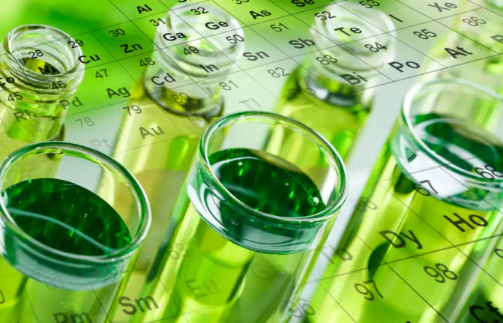
RESEARCH GAP
Existing pharmaceutical quality assurance protocols lack standards for incorporating sustainability.
Current chromatographic methods emphasise performance but do not fully address solvent toxicity or eco-impact.
A systematic, green-centric HPLC QA framework is missing.

Slide 10
NOVELTY AND INNOVATION
Introducing plant-based, biodegradable, and less toxic solvents such as ethanol-water mixtures.
Employing sustainable mobile phases reduces solvent consumption and hazardous waste generation.
Coupling these innovations with regulatory-compliant validation ensures green methods are practical and reliable.

Slide 11
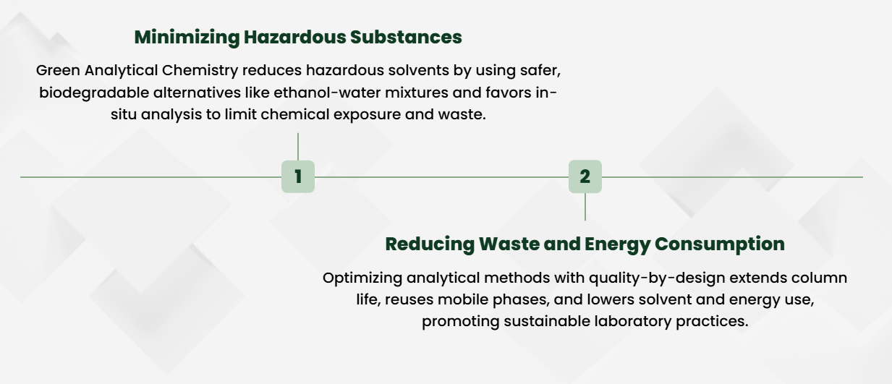
PRINCIPLES OF GREEN ANALYTICAL CHEMISTRY

Slide 12
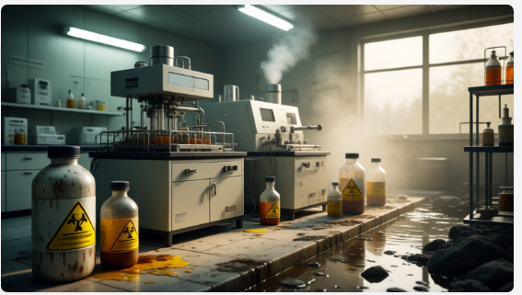
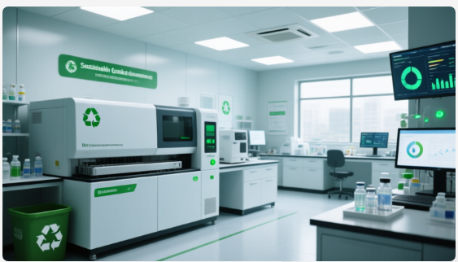
STRATEGIES FOR IMPLEMENTING GREEN HPLC
Replace toxic solvents (acetonitrile, methanol) with ethanol or aqueous solvents.
Employ micellar liquid chromatography that uses surfactant solutions eliminating organic solvents.
Optimize chromatographic conditions using quality-by-design to maximize efficiency with minimal resource inputs.

Slide 13
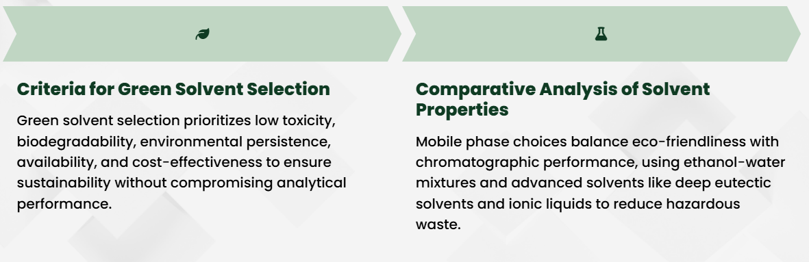
SOLVENT AND MOBILE PHASE SELECTION CRITERIA

Slide 14
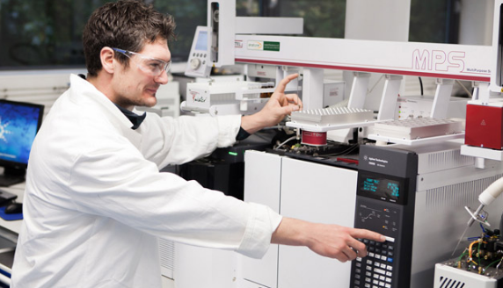
REGULATORY TRENDS IN PHARMA QA
Regulations by the WHO, FDA, and EMA emphasise environmental responsibility and safer lab practices.
Incorporation of green methodologies is increasingly encouraged during drug development and batch testing.
Green HPLC aligns pharma testing with these regulatory frameworks for sustainable compliance.

Slide 15
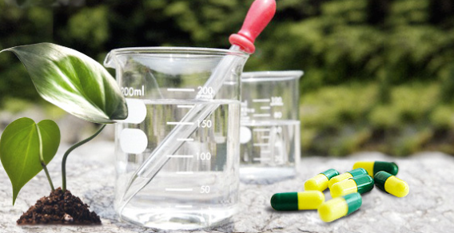
GREEN HPLC–QA FRAMEWORK OVERVIEW
Step 1: Selection and screening of green solvents and mobile phases.
Step 2: Method development using Design of Experiments to optimize conditions.
Step 3: Validation against standard metrics while incorporating greenness assessment tools (AGREE, GAPI).
Step 4: Routine application and ongoing monitoring of eco-performance.

Slide 16
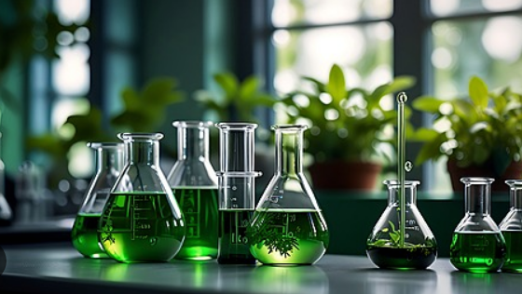
METHOD DEVELOPMENT & VALIDATION
Utilize quality-by-design to reduce trials, resource use, and time in method optimization.
Ensure method parameters achieve target chromatographic performance (resolution, sensitivity).
Validate robustness and reproducibility with comprehensive green metrics assessments.

Slide 17
CASE STUDIES: SUCCESSFUL GREEN HPLC IMPLEMENTATIONS
Example: Ethanol-water mobile phase for ibuprofen achieved equivalent accuracy while reducing environmental impact.
Favipiravir and other antivirals analyzed using solvent-free HPLC demonstrated increased sustainability.
These methods were validated per regulatory guidelines confirming reliability and eco-efficiency.

Slide 18
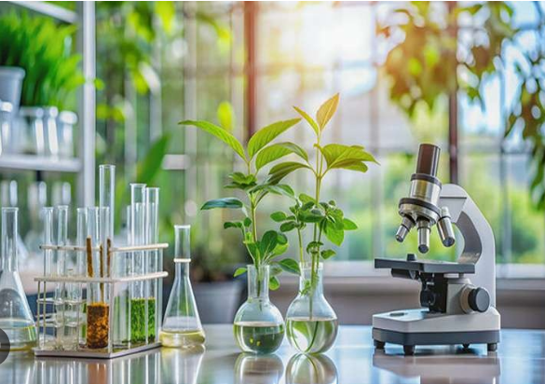
PHARMACEUTICAL APPLICATIONS
Green HPLC useful for drug formulation analysis, impurity testing, and therapeutic drug monitoring.
Applied in stability studies and bioequivalence testing with minimal ecological footprint.
Enables pharma companies to meet sustainability goals within quality standards.

Slide 19
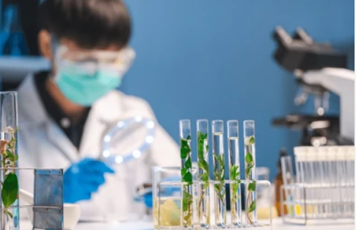
CHALLENGES IN ADOPTING GREEN HPLC
Miscibility and solvent strength differences require method re-optimization.
Compatibility with existing HPLC equipment and detectors can limit solvent choices.
Training and change management needed for lab personnel to adopt new eco-friendly protocols.

Slide 20
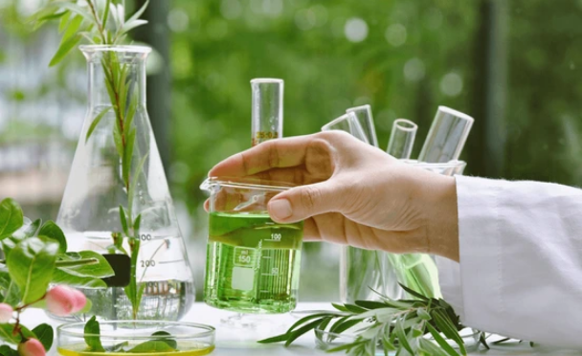
ENVIRONMENTAL AND OCCUPATIONAL IMPACT
Significant reduction in toxic solvent use cuts hazardous waste production.
Improvement in lab safety by lowering personnel exposure to volatile organic solvents.
Contributes to pharma industry’s corporate social responsibility and sustainability commitments.

Slide 21
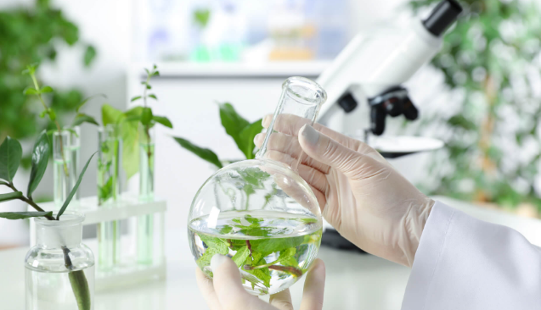
FUTURE DIRECTIONS
Development of miniaturized, microfluidic HPLC platforms using green solvents.
Integration of machine learning to predict optimal green method parameters quickly.
Expansion of green frameworks to other analytical techniques (GC, MS).

Slide 22
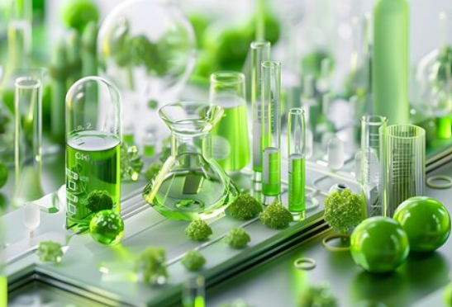
CONCLUSION
Green HPLC methods deliver high-quality pharmaceutical analysis with reduced environmental and health risks.
Frameworks combining eco-solvent selection with rigorous validation allow reliable, sustainable QA.
Transition to green chromatographic methods is essential for the future of responsible pharmaceutical manufacture and testing.

Slide 23
THANK YOU
REFERENCES
Yabré M, Choukrallah A, Guillarme D. Greening reversed-phase liquid chromatography: alternatives and strategies for greener RP-HPLC in pharmaceutical analysis. J Chromatogr A. 2018;1533:2–16.
Mikhail IE, Hassan EA, Abdel-Ghany MM, et al. Green micellar solvent-free HPLC and spectrofluorimetric methods for favipiravir: solvent-free micellar LC as a greener alternative. Anal Bioanal Chem Res. 2021
Imam MS, Hassan S, El-Sayad MA, et al. Adjusted green HPLC determination of nirmatrelvir and ritonavir: computational pre-testing of stationary phases. Sci Rep. 2023;13
Kelani KM, Abdel-Moneim AM, Mohamed NA, et al. Development of an eco-friendly HPLC method for the estimation of ibuprofen and phenylephrine: validation and greenness assessment. BMC Chem. 2023
Abd El-Hay SS, Abdel-Gawad RM, Elziny MA, et al. Cost-effective green HPLC method for losartan impurities (NDEA) using aqueous ammonium acetate mobile phase. J Pharm Anal. 2022;12

